Slide 1
Binary Search Tree

Slide 2
Binary Search Tree
Binary Search Tree is a binary tree data structure which has the following properties:
The left subtree of a node contains only nodes with keys lesser than the node’s key.
The right subtree of a node contains only nodes with keys greater than the node’s key.
The left and right subtree each must also be a binary search tree.

Slide 3
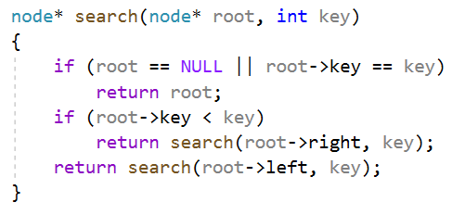
Binary Search Tree Searching a key: Implementation
To search a given key in Binary Search Tree, we first compare it with root, if the key is present at root, we return root.
If key is greater than root’s key, we recur for right subtree of root node.
Otherwise we recur for left subtree.

Slide 4
Binary Search Tree Searching a key: Example
We want to find 5:
7
3
8
1
5
9
4
6

Slide 5
Binary Search Tree Searching a key: Example
We want to find 5:
Comparing 7 and 5: 7 is greater, so continue with left subtree.
7
3
8
1
5
9
4
6

Slide 6
Binary Search Tree Searching a key: Example
We want to find 5:
Comparing 7 and 5: 7 is greater, so continue with left subtree.
Comparing 3 and 5: 3 is smaller, so continue with right subtree.
7
3
8
1
5
9
4
6

Slide 7
Binary Search Tree Searching a key: Example
We want to find 5:
Comparing 7 and 5: 7 is greater, so continue with left subtree.
Comparing 3 and 5: 3 is smaller, so continue with right subtree.
We found 5.
7
3
8
1
5
9
4
6

Slide 8
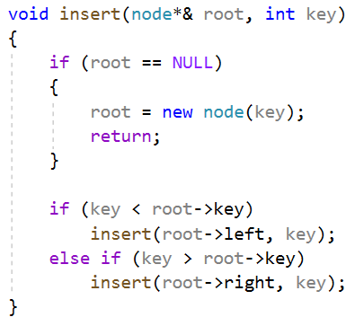
Binary Search Tree Insertion of a key: Implementation
A new key is always inserted at leaf.
We start searching a key from root till we hit a leaf node.
Once a leaf node is found, the new node is added as a child of the leaf node.

Slide 9
Binary Search Tree Insertion of a key: Example
We want to insert 4.
8
2
9
1
3

Slide 10
Binary Search Tree Insertion of a key: Example
We want to insert 4.
We compare 4 with 8: 8 is greater, so continue in left subtree.
8
2
9
1
3

Slide 11
Binary Search Tree Insertion of a key: Example
We want to insert 4.
We compare 4 with 8: 8 is greater, so continue in left subtree.
We compare 4 with 2: 2 is smaller, so continue in right subtree.
8
2
9
1
3

Slide 12
Binary Search Tree Insertion of a key: Example
We want to insert 4.
We compare 4 with 8: 8 is greater, so continue in left subtree.
We compare 4 with 2: 2 is smaller, so continue in right subtree.
We compare 4 with 3: 3 is smaller, so continue in right subtree.
8
2
9
1
3

Slide 13
Binary Search Tree Insertion of a key: Example
We want to insert 4.
We compare 4 with 8: 8 is greater, so continue in left subtree.
We compare 4 with 2: 2 is smaller, so continue in right subtree.
We compare 4 with 3: 3 is smaller, so continue in right subtree.
Right subtree is empty, so inserting node here.
8
2
9
1
3
4

Slide 14
Binary Search Tree Deletion of a key
When we delete a node, three possibilities arise:
First, node to be deleted is a leaf:
8
2
9
1
3
4

Slide 15
Binary Search Tree Deletion of a key
When we delete a node, three possibilities arise:
First, node to be deleted is a leaf:
Simply remove from the tree.
8
2
9
1
3
4

Slide 16
Binary Search Tree Deletion of a key
When we delete a node, three possibilities arise:
Second, node to be deleted has only one child:
8
2
9
1
3
4

Slide 17
Binary Search Tree Deletion of a key
When we delete a node, three possibilities arise:
Second, node to be deleted has only one child:
Copy the child to the node and delete the child.
8
2
9
1
3
4

Slide 18
Binary Search Tree Deletion of a key
When we delete a node, three possibilities arise:
Second, node to be deleted has only one child:
Copy the child to the node and delete the child.
8
2
9
1
4

Slide 19
Binary Search Tree Deletion of a key
When we delete a node, three possibilities arise:
Third, node to be deleted has two children:
8
2
9
1
3
4

Slide 20
Binary Search Tree Deletion of a key
When we delete a node, three possibilities arise:
Third, node to be deleted has two children:
Find inorder successor of the node.
Copy contents of the inorder successor to the node and recursive delete the inorder successor.
Note that inorder predecessor can also be used.
8
2
9
1
3
4

Slide 21
Binary Search Tree Deletion of a key
When we delete a node, three possibilities arise:
Third, node to be deleted has two children:
Find inorder successor of the node.
Copy contents of the inorder successor to the node and recursive delete the inorder successor.
Note that inorder predecessor can also be used.
8
3
9
1
4

Slide 22
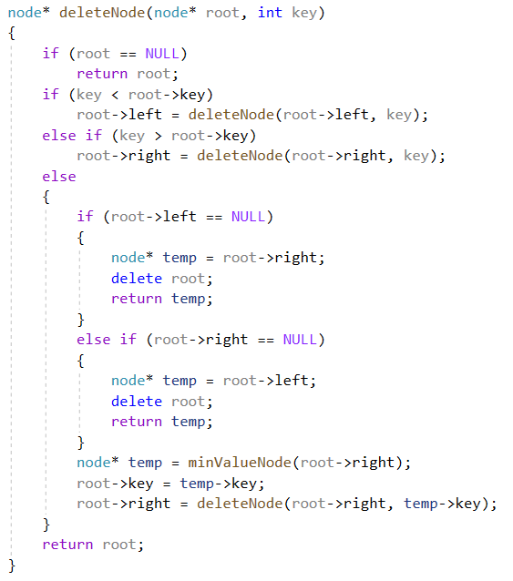
Binary Search Tree Deletion of a key: Implementation

